Slide 1


Understanding emotional driving factors of vaccination hesitancy and refusal in Bangladesh using Machine Learning approaches

Slide 2
Supervised by
Presented by
Adnan Ferdous Ashrafi,
(Senior Lecturer)
(Department Of Computer Science & Engineering)
Stamford University Bangladesh
Abdullah Al Mamun
ID: CSE 070-08109
Batch: 70-A
Mahfuzur Rahman
ID: CSE 070-08111
Batch: 70-A

Slide 3
Content of this slide
01
02
03
04
05
06
Introduction
Literature review
Methodology
Experimental setup
Result & analysis
Conclusion

Slide 4
01
INTRODUCTION

Slide 5
Introduction
What is vaccine?
Why do we need vaccine?
Why should we got vaccinated?
What is Emotional drivers?
Relation between vaccination and emotional driver
Motivation of this domain.
Why do we choose this domain?
Research outcome
Types of tools and methods
Google Colab
Pandas
Numpy
Seaborn
Matplotlib

Slide 6

02
LITERATURE REVIEW

Slide 7
LITERATURE REVIEW
Walsh et. al [1]
Factors Influencing COVID-19 Vaccine Hesitancy and Acceptance
Past vaccination behavior, risk perception, social influences and civic responsibility
Government and healthcare providers
Rancher et. al [2]
Understanding COVID-19 Vaccine Hesitancy in the United States
Race, ethnicity, socioeconomic status
Open communication and equitable access to vaccination
Raut et. al [3]
Understanding COVID-19 Vaccine Acceptance and Hesitancy
Misinformation, conspiracy theories and political polarization
Vaccin literacy, trust in vaccin and government

Slide 8
LITERATURE REVIEW
Gupta et.al [4]
A Comprehensive Analysis of COVID-19 Dynamics: Insights from Statistical and Machine Learning Approaches
Demographic, medical and vaccination
Find the factors influence most
Saifuzzaman et. al [5]
Navigating the Impact of COVID-19: A Multifaceted Literature Review
Brought unusual challenges
Educational disruption, economic challenges,
Mental health, reshaping the social norms

Slide 9



03
Methodology

Slide 10
Methodology
Dataset description
Actual dataset [6]
500 rows( Men 250, women 250) &195 columns
Divided into sub-parts:
1. Descriptive & Demographic fields
Domain of this subpart | Description | Name of columns
Descriptive fields | 8 columns | ( Id, survey_Start date ,survey_End date ,Duration in second, Info consent, redirect, finished, status_R)
Demographic fields | 9 columns | ( age, sex, district, religion, marital_status, education, education_other,conib, household )

Slide 11
Methodology
2. Individual Differences
Domain of this subpart | Description | Name of average columns
The Big Five personality traits | comprises 30 items/columns,forming 5 | ( BFI_agree, BFI_cons, BFI_negam, BFI_extra, BFI_open)
Horizontal-Vertical,Individualism-Collectivism (HVIC) | comprises 14 items, forming four subscales | ( HVIC_HC_avg, HVIC_VC_avg, HVIC_HI_avg, HVIC_VI_avg )
Future Consequences (CFC) scale | comprises 14 items/columns,forming 2 columns | ( CFC_F_avg, CFC_I_avg )
General Prosocial tendencies | comprises 23 items/columns,forming single column | ( prosoc_ALL_avg )

Slide 12
Methodology
3. Emotional responses & Threats
Domain of this subpart | Description | Name of average columns
Feelings of helplessness related to the vaccination, the COVID-19 pandemic, and climate | Comprises 12 items/columns,forming 3 columns | ( helplessness_CLIM_avg, helplessness_COV_avg, helplessness_VAC_avg )
Feelings of threat related to vaccination against the COVID-19 disease, the disease itself, and climate change | Comprises 9 items, forming 3 subscales | ( threat_CLIM_avg, threat_COV_avg, threat_VAC_avg )

Slide 13
Methodology
4. Prosocial Intentions and Behaviour
Domain of this subpart | Description | Name of average columns
Prosocial behavior | Comprises 21 items/columns,forming 3 | (procovid_avg, proenviro_avg, provacc_avg)
Prosocial Altruistic | Comprises 5 items, forming single average column | (prosoc_ALT_avg)
Attitudes towards vaccination | comprises 10 items/columns,forming 5 | (prosoc_EMO_avg,prosoc_PUB_avg,prosoc_DIR_avg,prosoc_COM_avg, prosoc_ANO_avg)
Anti vaccination average | comprises 4 items/columns,forming single column | (antivacc_avg)

Slide 14
Methodology
Validation dataset
48 response and 30 columns
Collected by google form
Data Preprocessing
Actual dataset
Get 30 columns from 195 columns and made a new data frame for further operation.
Drop index column.
Target variable binning and converted data type as integer.
Converted categorical columns into integer value using lambda expression.
Applied min-max normalization for normalizing columns (Not on target column).
Applied feature selection technique and selected 20 columns for final operation.

Slide 15
Methodology
Data Preprocessing
Validation dataset
Drop 4 irrelative columns( Timestamp, name, profession,info_consent)
Use lambda function, mapping and astype function to convert categorical to numerical value
Applied min-max normalization technique to normalize all value
Visualized all columns (Boxplot, Histogram, scatterplot)
Then applied machine learning models.

Slide 16
04
Experimental Setup

Slide 17
Experimental setup
Techniques used for preprocessing | Models, Techniques & Algorithms used for result | Evaluation matrix
Min-Max Normalization Round function Feature engineering | Linear SVM Radial SVM Logistic Regression K-Neighbour Classifier Decision Tree classifier Gradient Boosting Classifier Random Forest Classifier Naive Bayes | Accuracy Precision Recall F1-Score RSME

Slide 18
05
Result & Analysis

Slide 19
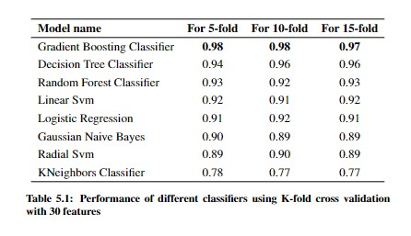
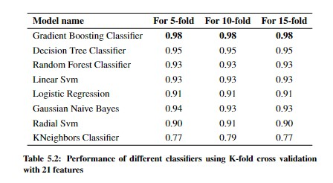
Result & Analysis
K-fold cross validation

Slide 20
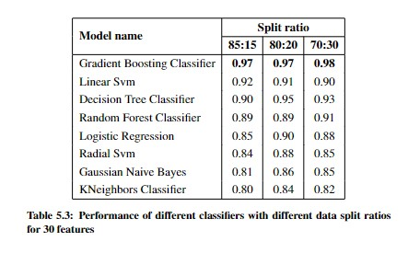
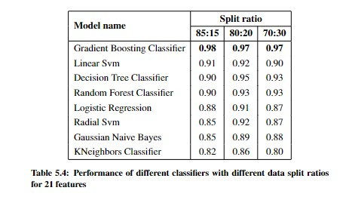
Result & Analysis
Split ratio and accuracy

Slide 21
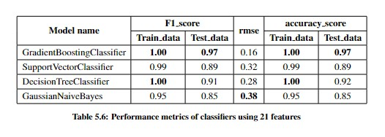
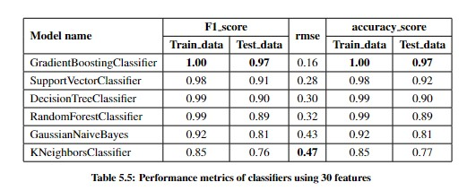
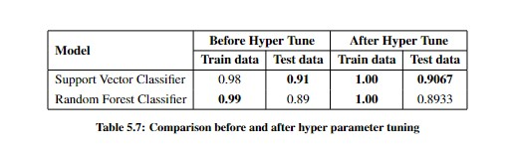
Result & Analysis
Individual performance matrix and hyper parameter tuning

Slide 22
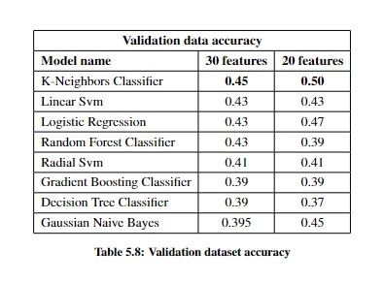
Result & Analysis

Slide 23
06
Conclusion

Slide 24
Conclusion:
Limitation:
Inadequate data to feed the model.
Could not collect sub parts of each average columns.
Demographic fields prevents better accuracy.
Future work:
Using emotional data delve into psychological research.
Create a model that will work for globally not demographically.

Slide 25
BIBLIOGRAPHICAL REFERENCES
[1] J. C. Walsh, M. Comar, J. Folan, S. Williams, and S. Kola-Palmer, “The psychological and behavioural correlates of covid-19 vaccine hesitancy and resistance in ireland and the uk,” Acta Psychologica, vol. 225, p. 103550, 2022. [Online]. Available: https://www.sciencedirect.com/science/article/pii/S0001691822000658
[2] C. Rancher, A. D. Moreland, D. W. Smith, V. Cornelison, M. G. Schmidt,J. Boyle, J. Dayton, and D. G. Kilpatrick, “Using the 5c model to understand covid-19 vaccine hesitancy across a national and south carolina sample,” Journal of Psychiatric Research, vol. 160, pp. 180–186, 2023. [Online]. Available: https://www.sciencedirect.com/science/article/pii/S0022395623000778
[3] A. Raut, A. Samad, J. Verma, and P. Kshirsagar, “Acceptance, hesitancy and refusal towards covid-19 vaccination,” Clinical Epidemiology and Global Health, vol. 21, p. 101283, 2023. [Online]. Available: https://www.sciencedirect.com/science/article/pii/S2213398423000702
[4] H. Gupta and O. P. Verma, “Vaccine hesitancy in the post-vaccination covid-19 era: A machine learning and statistical analysis driven study,” Evolutionary Intelligence, vol. 16, no. 3, pp. 739–757, 2023.
[5] M. Saifuzzaman, M. M. Rahman, S. F. Shetu, and N. N. Moon, “Covid-19 and bangladesh: situation report, comparative analysis, and case study,” Current Research in Behavioral Sciences, vol. 2, p. 100034, 2021.
[6]M. Adamus, V. ˇCavojov ́a, and E. Ballov ́a Mikuˇskov ́a, “Emotional drivers of the vaccination hesitancy and refusal: A dataset from slovakia,” Data in Brief, vol. 47, p. 108980, 2023. [Online]. Available: https://www.sciencedirect.com/science/article/pii/S2352340923000987

Slide 26
THANKS!
Do you have any questions?

